Slide 1
SWAN Member’s Quarterly Meeting
March 6, 2014

Slide 2
THANK YOU

Slide 3
Report & Recommendation
Highlights
Membership Involvement
Research Conducted
Library Survey
Consultant & RFP
RBFO & BAFO & RFC
Reference Checks
Cost Analysis

Slide 4
What is in this Deal?
What Do You Get on Day One?
Circulation?
Cataloging?
Acquisitions?
Serials?
OPAC?
We have that taken care of… BUT THERE IS MUCH MORE
Why SirsiDynix?
What’s Coming?
What’s BLUEcloud?
Migration?
Costs?

Slide 5
The DEAL: For Starters, Symphony Has More
Circulation & Offline Circ
OutReach
Cataloging & Authority control
Selection & Acquisitions
Serials Control, Checkin, and Routing
Materials Booking
Academic Reserves
System Administration & Utilities
Integrated Reporting
Symphony ILS

Slide 6
The DEAL: Symphony Workflows

Slide 7
The DEAL: A New Client is Coming
BLUEcloud Staff Client
INCLUDED

Slide 8
The DEAL: Not Just An OPAC
…Discovery
Search based on latest technology that can allow my library branding?
INCLUDED
With full E-Book integration?
INCLUDED
Oh, and wouldn’t it be nice if it included E-journals too!
YOU GOT IT

Slide 9
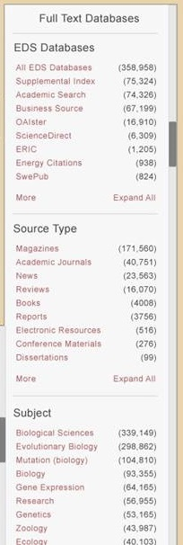
The DEAL: Not Just An OPAC
Enterprise
Search platform
An instance for every SWAN library (your library logo)
Local collection & Consortia collection
E-Books
Databases

Slide 10
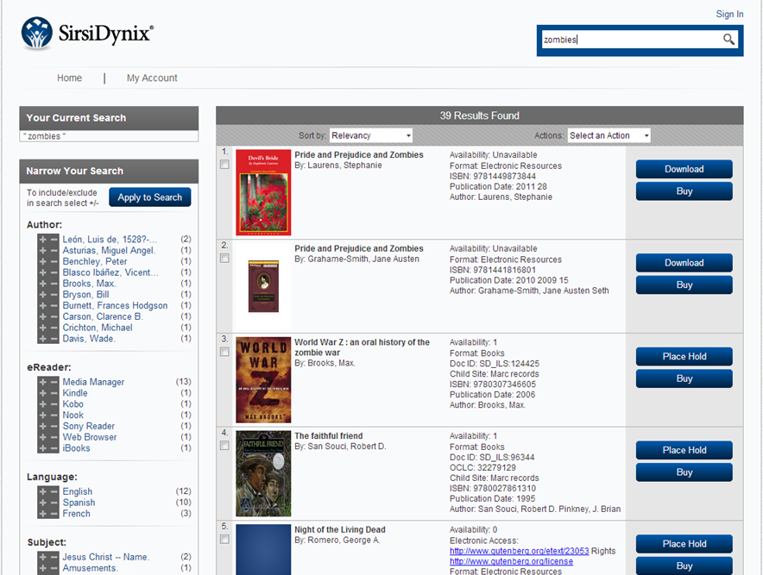
The DEAL: Full E-Book Integration
eResource
Central
Enterprise module for
Streamlined digital downloads
Vendor management
eResource management

Slide 11
The DEAL: Full E-Book Integration
eResource Central
OverDrive
My Media Mall
eMedia Library
Media on Demand
OverDrive Advantage accounts
3M Cloud
B&T Axis 360
Full eBook integration
No MARC loading by SWAN staff
Patron placed
holds
Patron download from OPAC

Slide 12
The DEAL: More Searching for Patrons
Your patrons will have search options beyond your collection, SWAN libraries
EBSCO Discovery Services (EDS): partnership with SirsiDynix
Integration with EBSCO & Enterprise
Gale possible
YOU GOT IT

Slide 13
The DEAL: How About Mobile Devices for Staff
MobileCirc
Checkouts
Checkins
Renewals
Add a patron
Modify a patron
Inventory
Pull onshelf items to fill holds list report
Remotely print hold slip
Or mark item missing
and of course, offline circ

Slide 14
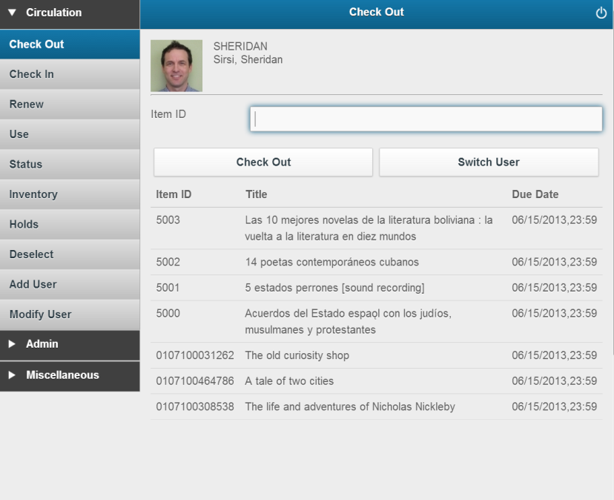
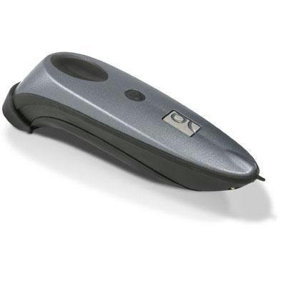
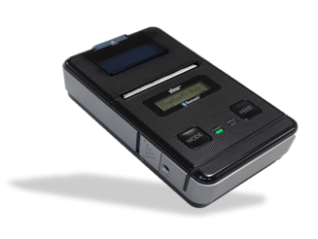
The DEAL: Mobile Devices for Staff
MobileCirc
Runs on iPad, Android, or browser
Runs limited circulation
Inventory!
Works with Bluetooth scanners & printers

Slide 15
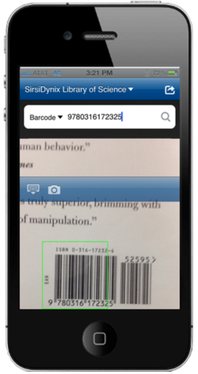
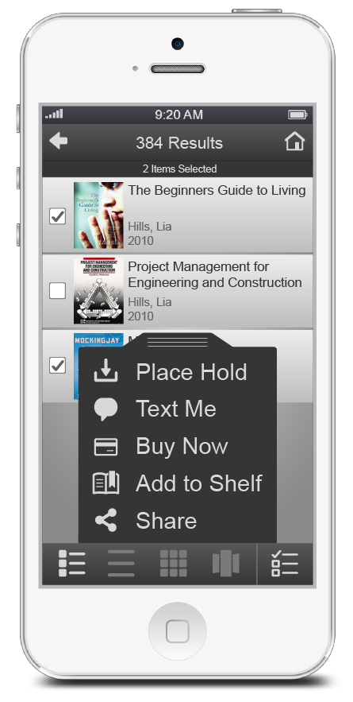
The DEAL: Something for the Public Always on the Go
It’s called Bookmyne+ phone app
Patrons can locate local libraries using GPS maps
Scan ISBN off book jacket and search for item in their library
Place a hold
Update their email address in their patron record
Your Library can brand their instance using name, icon, colors, and even integrate an RSS feed

Slide 16
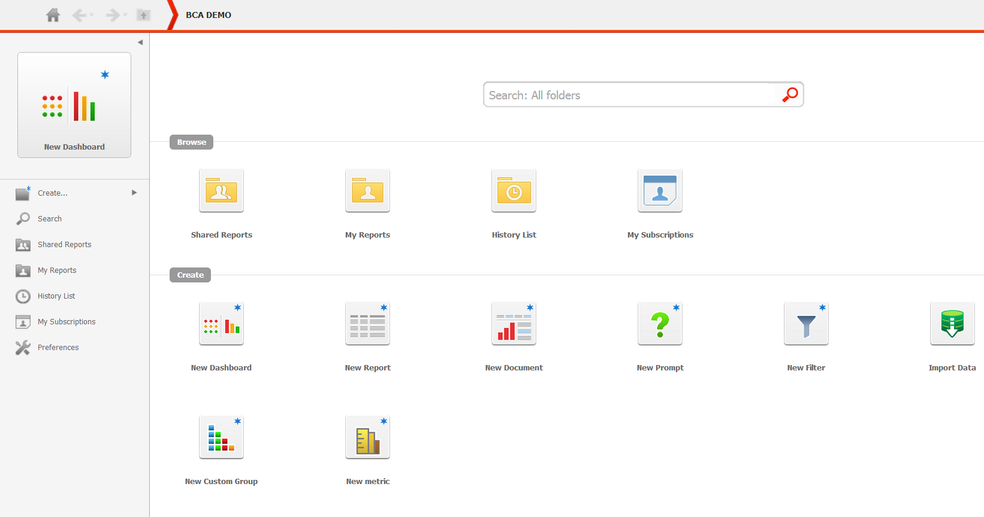
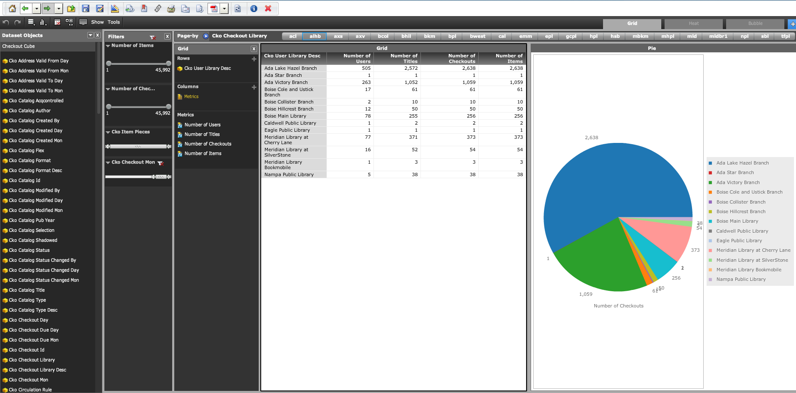
The DEAL: Data Analysis
Analytics: Merger of Director’s Station & Web Reporter product lines
Covers Symphony + all new products
Drag & Drop analytics
Output in multiple formats
Automatic subscriptions to reports
Easy drill-down, filtering, graphs, sorting, etc.
Import local databases
Includes support for tablets and smartphones

Slide 17
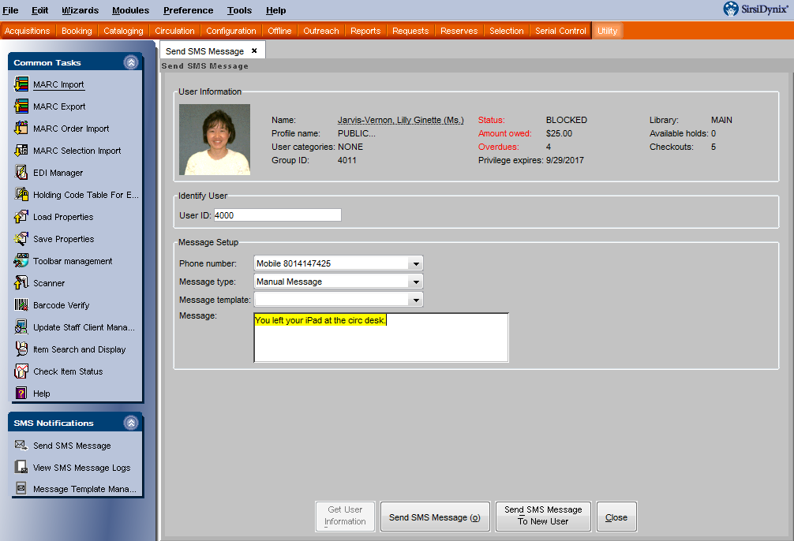
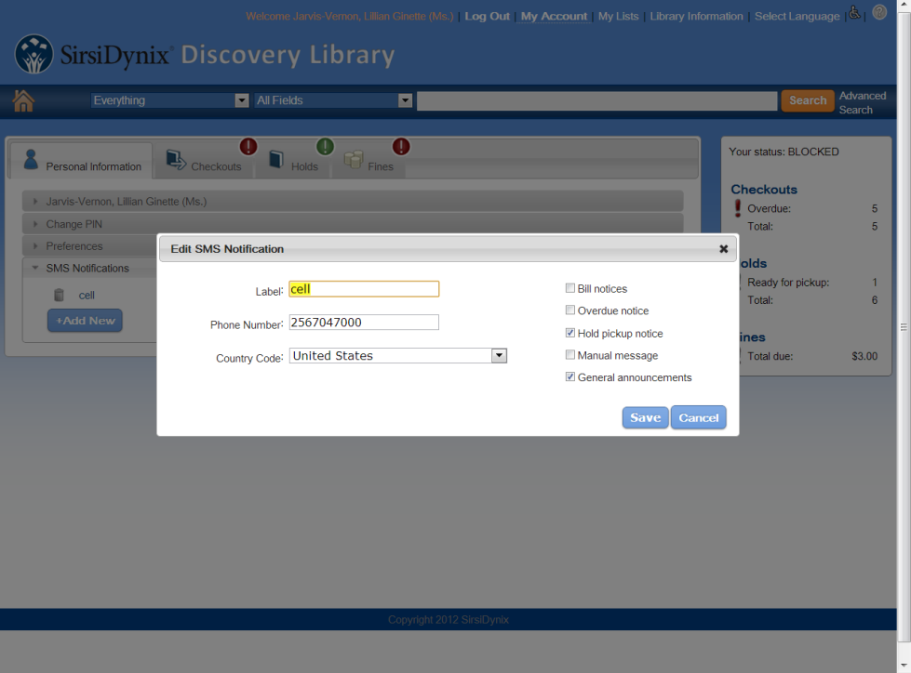
The DEAL: Notification for Mobile Patrons
Text Messaging
Integrated Symphony module
Automated
Opt-in
Send SMS ad-hoc and in batch
Patrons can “opt-in” by adding SMS notification numbers via Enterprise.

Slide 18
The DEAL: Additional Integrated Modules
SirsiDynix Voice Automation (SVA)
Text Messaging (SMS)
Email Notification
Print Notification
Debt Collection

Slide 19
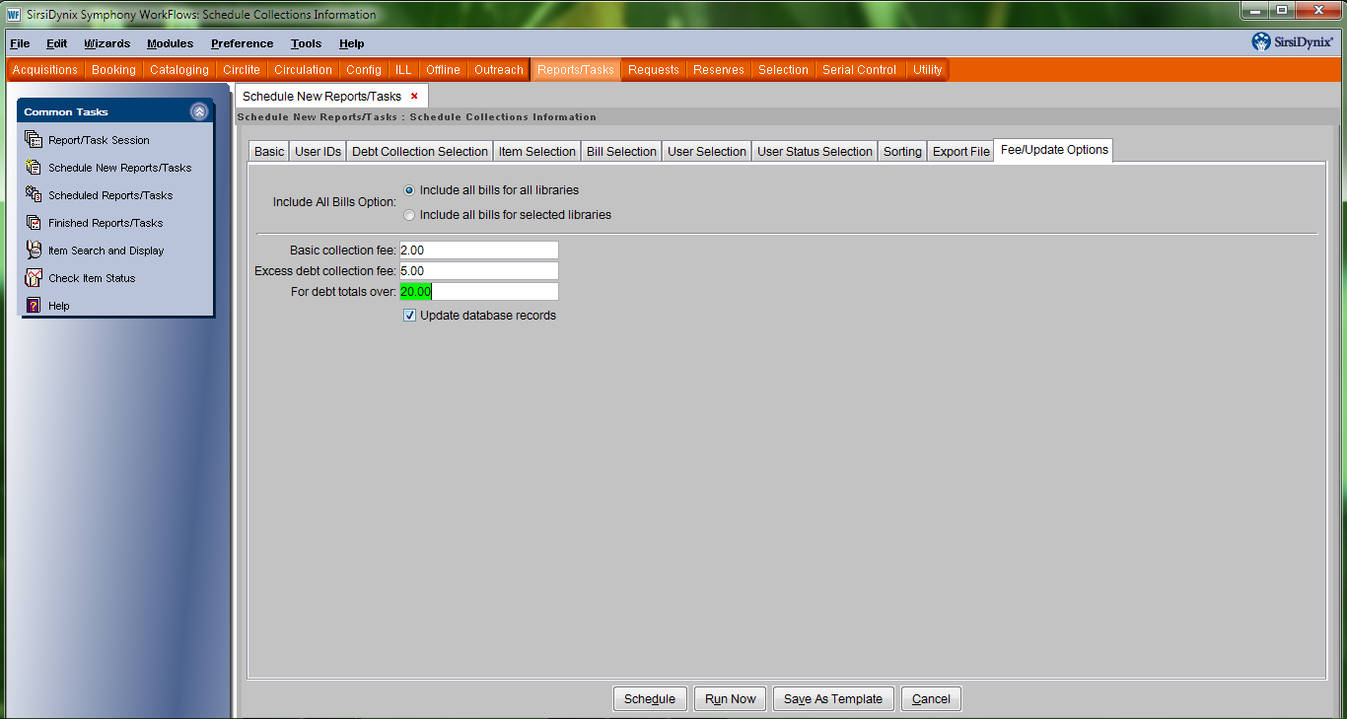
The DEAL: Debt Collection
Delinquent Accounts
Debt collection
Integrated with Unique

Slide 20
The DEAL: Licensing
Unlimited Staff Licenses
No more “All Ports in Use”
Unlimited SIP2 Licenses
No more extra cost to your maintenance bill
No extra cost when your library needs it

Slide 21
The DEAL: Integration Beyond the ILS
SirsiDynix 3rd Party Alliance
Vendors whose products and services complement and enhance SirsiDynix offerings in the marketplace
3M
B&T
Bibliotheca
Boopsie
Comprise
D-Tech
EnvisionWare
Library Ideas
MK Sorting
Sentry
SingleCard/TBS
Talkingtech

Slide 22
But wait there’s more!

Slide 23
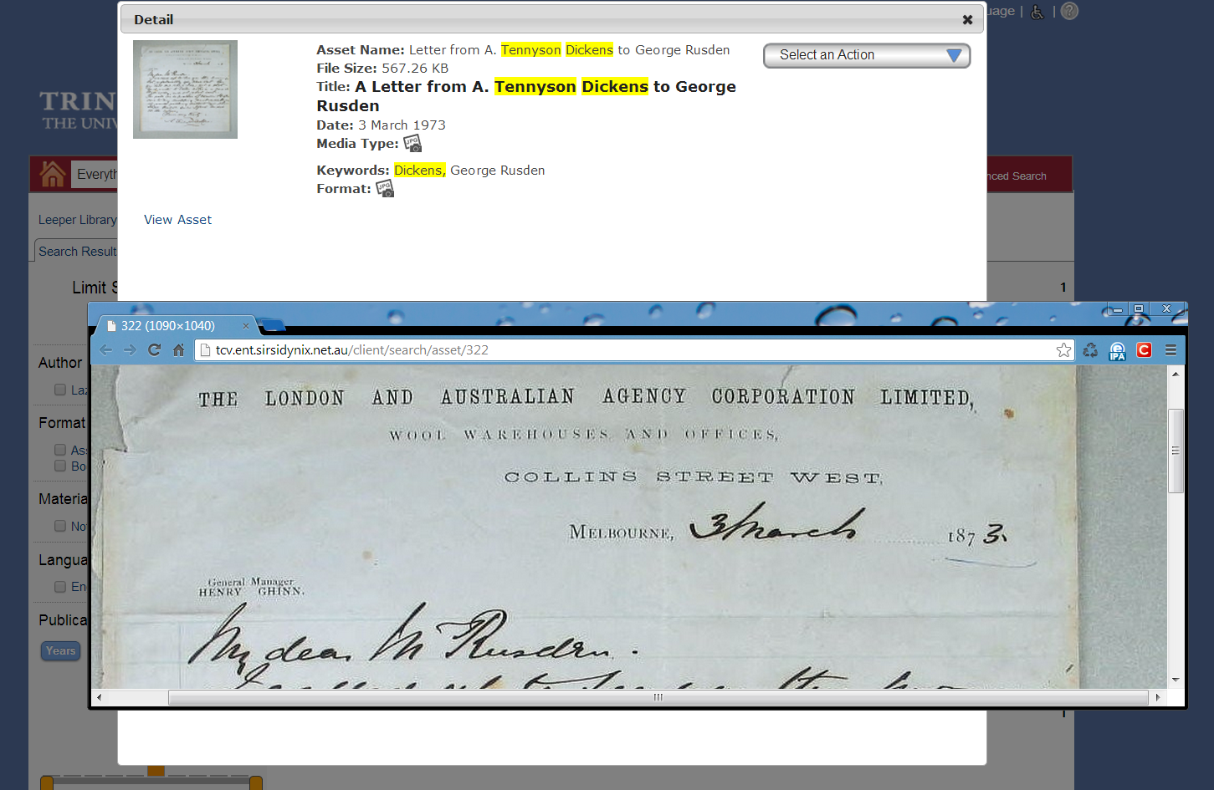
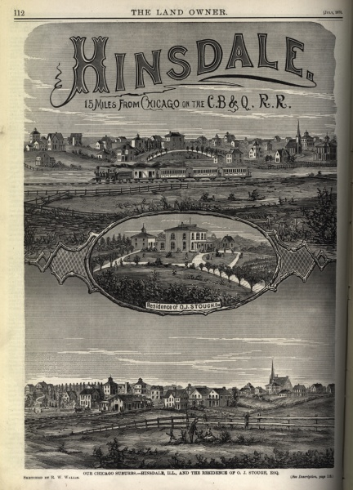
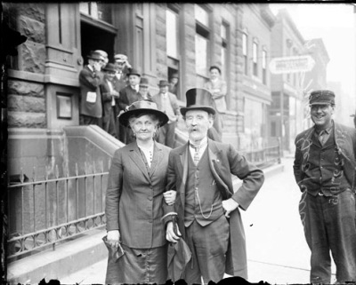
The DEAL: Your Digital Collections Available within Your Library Catalog
Portfolio
digital asset management, digital collections
Portfolio
Within Your Catalog
Image storage
Asset Security
Metadata editing
Metadata Import/Export
OAI PMH compliance

Slide 24
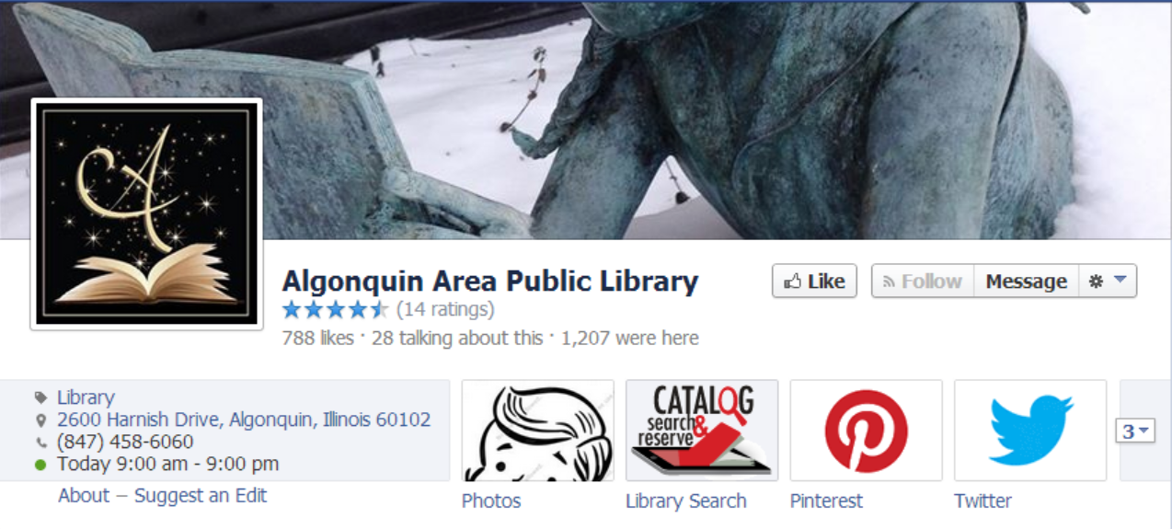
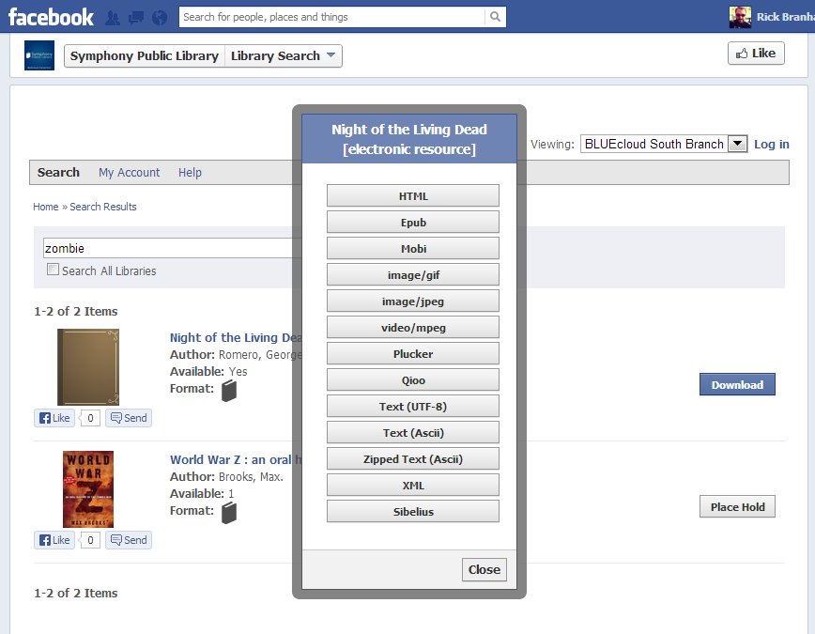
The DEAL: What about My Library Social Media Presence?
Social Library
Native Facebook App
Catalog and Account Management
Patrons can link their search your catalog, “like” items, write reviews, place holds, pay fines, download eBooks, Audio Books, etc.

Slide 25
The DEAL: What about my Homebound Patrons?
Symphony Outreach
Build a profile of your homebound patron’s interests
Suggests items from your collection to deliver to patron
Tracks their reading history
Assists with development of delivery routes

Slide 26
The DEAL: Did We Mention E-commerce?
Of course patrons can continue to pay bills through the OPAC
How about patrons paying bills with a credit card at the circ desk? We have options for you!
BLUEcloud Marketplace

Slide 27
The DEAL: Ongoing Training
“Mentor” Online Learning Management
Online self-paced training
Dozens of different topics
Basic/introductory/overview sessions
WorkFlows Essential Skills
Cataloging Basics
New features and releases
Training will be available before and during migration, as well as afterward - anytime new staff are added.

Slide 28
What could possibly be left? I don’t know –let’s make all the major modules available for staff through a web based interface … BLUE cloud

Slide 29
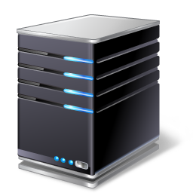
SWAN Symphony & BLUEcloud 2014-2015
Staff Apps
Global Data Centers
Hosting for BLUEcloud Apps
BLUEcloud Staff
Universal Admin
eResource Central
MobileCirc
Analytics
Databases, Z39.50, Websites
Social Library
Enterprise
BookMyne
Portfolio: Digital Asset Management
Discovery Apps
Staff & Public Users:
Desktop Browser or SmartPhone/Tablet
The Internets
SWAN
Burr Ridge
SWAN
Libraries
Symphony Production and Test Systems

Slide 30
BLUEcloud Suite
BLUEcloud
Staff
BLUEcloud
Marketplace
BLUEcloud
Discovery
MobileCirc
Enterprise
Social Library
2014
BLUEcloud Analytics
eResource Central
Portfolio
BookMyne+
Universal Admin
Global Vendor Access
BLUEcloud PAC
2014
2015
2014
Cataloging
Global Title Lists
BookMyne
2014
2015
Circulation
Community Funded Services
2015
Acquisitions
2015
Serials
= Currently Available

Slide 31
COMING: Staff Client “Webified”
INCLUDED

Slide 32
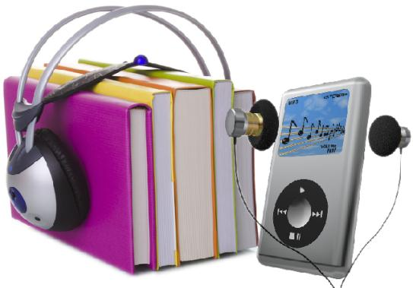
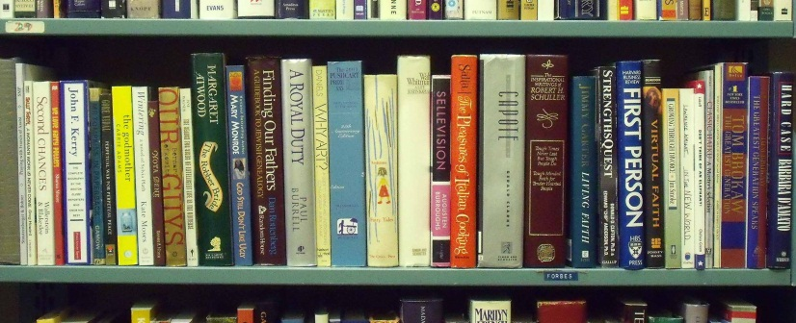
COMING: BLUEcloud MarketPlace
Repository of ALL Title Metadata
eBooks
Audio Books
eJournals & Databases
Print Materials
It’s the Metadata – Not the content
Enables per Library Control of:
Place a Request
Buy it Now For the Student/Patron
Buy and Donate to the Library
Demand Driven Acquisitions (DDA)
Rentals
Many More
No Dead Ends
INCLUDED

Slide 33
The DEAL: How We Get There
Migration & Training

Slide 34
Data Migration
Experienced conversion from Innovative Interfaces and any delimited data sets
SWAN exports data in delimited format
SirsiDynix data services converts to Symphony format and loads
Two complete data loads (initial load & final load); no gap period required

Slide 35
Policy Configuration
Dedicated Project Manager—single point of contact
Policy Consultation: Professional, experienced consultant
Online profiling and data mapping
Customization Consultation: API, Web Services, Workflow, Web Design

Slide 36
Training
Mentor: e-training for initial and ongoing training
Distance: live lectures or hands-on sessions using web conference and remote desktop
Onsite: hands-on sessions with SWAN trainers

Slide 37
Support
Centralized support from SWAN
SirsiDynix Support Website, Online Documentation & Mentor
Library Relations Manager for SWAN: senior staff, onsite visits, case escalation, project coordination
Platinum Services: 24x7 support, consulting, eLearning, training discounts

Slide 38
The MIGRATION: A Twist
Patron Photos: 7 SWAN Libraries
Supported in Symphony 3.4
Cicero
Eisenhower
Hillside
Lyons
Markham
Melrose
Markham Bookmobile
Digital Signatures: 25 SWAN Libraries
Not supported currently
Targeted for Symphony 3.5 scheduled for December 2014

Slide 39
The MIGRATION
Millennium Express Lane
No SirsiDynix Self-check solution
Express Lane libraries will need a new solution
SWAN Researching Options
3M, Bibliotheca, Free Open-source
We will provide recommendations
Thin Clients
We are Finalizing the recommended minimum requirements
If your library is running Millennium or WebPAC/Encore now, you should be fine
Contact Steven Schlewitt, SWAN IT Manager
SWAN Requested Survey

Slide 40
The COMPANY: Very Robust

Slide 41
Recent Consortia Customers
13 library systems, including Houston Public Library, and 66 locations
Former III customer
SirsiDynix beat III, Polaris, open source solutions and other vendors
Moving to Symphony Cloud
With Enterprise, Portfolio, Social Library, Bookmyne+, Platinum Services and Voice Automation
Northern Ireland Libraries
The library system for all of Northern Ireland: 100 locations plus 26 mobile libraries
Former Axiell customer
SirsiDynix beat III, Polaris, open source solutions and other vendors
Moving to Symphony Cloud

Slide 42
SirsiDynix Consortia in ILLINOIS
CCS
Arlington Hts
24 public libraries
15.6 million annual circ
LINC
St Charles
9 public libraries
4.7 million annual circ
RSA
East Peoria/RAILS
152 multitype libraries
6.3 million annual circ
MAGIC
DuPage/RAILS
14 libraries
2 million

Slide 43
The COMPANY: DEVELOPERS
Announced: expanding software development department with 39 additional hires in 2014, building on its substantial hiring increase in 2013
The 2013 Library Journal Automation Marketplace Survey shows that SirsiDynix is within the top three for the number of software developers employed among major ILS vendors
SirsiDynix will have 129 developers on staff by the end of 2014
Why are so many developers being hired? SirsiDynix leadership and its venture capital owners are investing in the BLUEcloud suite platform

Slide 44
Strategic Partner Program
Strategic Partnership Program
Available to all customers
Not Beta, Not Alpha, Early Software Development Input
SWAN opportunities to participate and have a voice in future product development
COSUGI
Annual Conference 2014
Detroit
May 15 -17
Consortia Users Group
SIG
Consortia Special Interest Group
Chaired by Carol Dawe, LINC, DuPage, IL

Slide 45
The COST: Ongoing Maintenance
222,875 | SirsiDynix Annual Maintenance to SWAN (Years 2-5)
 | Zero % Maintenance Increases for 5 Years
279,748 | Current ILS Annual Maintenance to SWAN with III
69,600 | Annual Application Management Service with III
349,348 | Total Current Annual Maintenance with III
126,473 | Annual Savings in SWAN Operations Budget Line #5400 "Equipment Repair & Maintenance Agreements"

Slide 47
The COST: Purchase & Migration
Summary of Cost Request from SWAN Capital Reserves
 | 834,000 | SWAN Budget for Future ILS Migration (from Capital Budget)
 | (407,930) | SirsiDynix purchase, licenses, migration & implementation services
 | (70,200 – 92,000) | Additions to Existing Hardware (estimated cost prior to bid)
 | (478,130 – 499,930) | Total Budget Estimate
 | 355,870 – 334,070 | Under budget

Slide 48
Questions?
Overview of Proposal
Ongoing Maintenance
Capital reserve approval

Slide 49
SWAN Executive Director Report
Projects Completed
Upcoming Projects

Slide 50
Millennium R2011 Upgrade
Completed January 29, 2014
RDA patch R2011 1.3: We are Now Full RDA Record Compliant!
Issues encountered with Circulation printing, Express Lane: Resolved
Now Most Current Version for SWAN: no other Millennium Releases Announced

Slide 51
Upcoming Projects March – May 2014
Complete Network Changes
Conducted Online Webinar
COMPLETED: Memo #8 FQDN Migration
Last Step: Complete external & internal IP address changes
Memos #9 & #10 Coming
Final Date to be Announced

Slide 52
Upcoming Projects March – June 2014
Data Clean-up
Template Review
Acquisitions Order Records
Patron Purge: COMPLETE
Patron Clean-up

Slide 53
Upcoming Projects Dec ‘12 – March ‘13
Complete ILS Selection
Final Recommendation
Contract Negotiation
SWAN Board Approval
Cost Approval By 77 Directors

Slide 54
3M Self-Check
On Loan to SWAN
Demo in RAILS Burr Ridge
RFID or Barcode Items
Patron Account
Renewals
Receipts

Slide 55
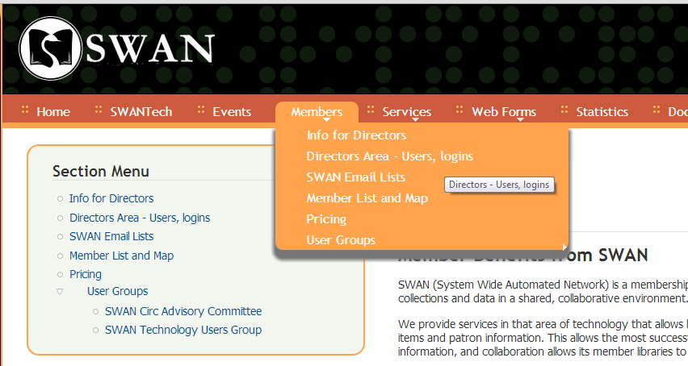
SWAN Quarterly Password Change
Password Changes
Use the support.swanlibraries.net website
Works from any browser, anywhere
Questions?

Slide 56
SWAN Meetings 2014
Upcoming Schedule
Committee of the Whole
Tuesday April 8, 2014 at RAILS Burr Ridge
Tuesday May 13, 2014 at Prairie State College
Quarterly Meetings: Burr Ridge
June 5, 2014 at RAILS Burr Ridge

Slide 57
End of Executive Director report
Look for this presentation here: http://support.swanlibraries.net/gov/meetings

