Slide 1
Identity, Mission, and Vision Clarification
SWAN
Strategic Planning
September 2018

Slide 2
Goals for today
Present key findings
Ensure you understand the content and ask clarifying questions
Feedback for adjustments
Establish the process for answering the questions presented – today is not meant to answer the questions necessarily.

Slide 3
Project Status
Background Research - COMPLETED
Discovery Interviews – COMPLETED
Identity, Mission, and Vision Clarification – NOW
Assessment – NOW
Strategic Plan
Tactical Plan
Executive Coaching
Notes:
How this report

Slide 4
What is Identity, Mission, and Vision?
Identity: How do you make decisions?
Mission: What is the problem in society that you are trying to solve?
Vision: What does your solution look like?

Slide 5
Nature of this phase
IMV clarity defines and should precede actual planning.
Get the “big picture” right first, and the rest falls into their right place.
More details and other issues will be presented in future phases.

Slide 6
Caveats for this phase
Because this phase focuses on what needs to be clarified, it can seem overly critical.
In reality, there are many positive aspects of SWAN that do not require further clarification or discussion – only affirmation.
Examples:
Achievement in integrating the “new 19”
Staff professionalism and morale
Operational improvements (especially with hiring of Dawne)
Financial stability and management

Slide 7
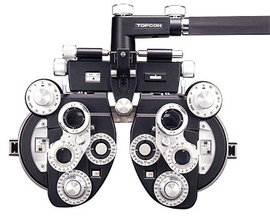
Nature of clarification
Clarification is helped by drawing contrasts and forcing either-or choices.

Slide 8
Four Clarification Issues
Identity: How do you make decisions?
Direct Democracy vs. Representative Democracy
Member-centric vs. Mission-centric
Mission: What is the problem you are trying to solve?
3. ”Public Utility” problem vs. “Climate Change” problem
Vision: What does your solution look like?
4. Software as End Product vs. Software as Transformative Platform

Slide 9
Four Clarification Issues
Identity: How do you make decisions?
Direct Democracy vs. Representative Democracy
Member-centric vs. Mission-centric
Mission: What is the problem you are trying to solve?
3. “Public Utility” problem vs. “Climate Change” problem
Vision: What does your solution look like?
4. Software as End Product vs. Software as Transformative Platform

Slide 10
Who makes the decisions?
Direct Democracy: Members vote on most decisions.
Representative Democracy: Members elect representatives to make most decisions.

Slide 11
Assessment of SWAN
Historical legacy as Direct Democracy
In legal form, SWAN has switched to Representative Democracy
But in actual practice and culture, SWAN exhibits some confusion and being stuck in between the two identities

Slide 12
Symptoms of confusion
Uncertainty in board decision making about the extent of their representative authority
Dissatisfaction with the quality of direct democracy at quarterly meetings
Pattern of reprocessing issues at different levels with a lack of decisiveness
Uncertain authorization for the ED and staff
Example of confusion: Advisory Committees

Slide 13
Our diagnosis
SWAN has outgrown the conditions necessary for an effective Direct Democracy:
Size
Equal ability to participate in Direct Democracy deliberations
Increasing heterogeneity = need to protect “minority interests” against “majority rule”
Complexity of issues
Potential need to act decisively in a context of rapid change

Slide 14
Our diagnosis
However, it has yet to fully establish the conditions of an effective Representative Democracy – at least in some member perceptions.
This is why SWAN feels caught in confusion “in between” the two identities.

Slide 15
Conditions that are perceived to be missing
Turnover in representation
Perception: the same libraries get seats
Representatives reflect the composition of members
Perception: dominated by larger libraries
Representatives will hear the concerns of members
Perception: lack of input channels
Staff reporting to elected representatives serve as “ears”
Perception: SWAN staff are not present enough onsite

Slide 16
Our recommendation
SWAN should be governed more clearly as a Representative Democracy in practice:
The board is elected to make high level decisions on behalf of the members.
The board empowers the ED to execute those high level decisions (and make decisions below that level).
The ED and staff are answerable to the board – not to all members.

Slide 17
Our recommendation
The strategic plan should include steps to insure that SWAN is perceived to meet more fully the required conditions of a Representative Democracy…
...without sliding back into Direct Democracy (i.e. proliferation of committees).

Slide 18
Our recommendation
Potential steps:
Clarify term limits around libraries (not just individuals)
Specific allocation of board seats (i.e. by size, region, etc.)
Expand seats to insure more representation
Change status to 501c3

Slide 19
Feedback and Discussion

Slide 20
Four Clarification Issues
Identity: How do you make decisions?
Direct Democracy vs. Representative Democracy
Member-centric vs. Mission-centric
Mission: What is the problem you are trying to solve?
3. “Public Utility” problem vs. “Climate Change” problem
Vision: What does your solution look like?
4. Software as End Product vs. Software as Transformative Platform

Slide 21
What is the criteria for decision making?
Member-centric: SWAN exists to do what members prefer. (Think: a condo co-op)
“What do you want?”
Mission-centric: SWAN exists to solve a particular problem in the world. (Think: Greenpeace)
“Do you want to join this effort?”

Slide 22
Why clarify this identity issue?
Even if SWAN clarifies who makes decisions (elected representatives), it still must clarify what criteria should guide those decision makers.
Are board members most beholden to membership preferences (which can be fluid) or to a mission (which should be fairly fixed)?
What does SWAN do when member preferences differ? Is there another criteria besides majority wins?
How much authority does the board (and hence the ED) have to proactively lead vs. just reactively service?

Slide 23
Assessment of SWAN
Historically and currently, SWAN leans heavily towards being Member-centric.
SWAN is an organization of Member Libraries (“Members,” “Membership”) participating in an Integrated Library System (“ILS”) which is dedicated to improving services for Member Libraries by sharing resources, technology, and a planned process of individual and collective growth.
What is missing in this statement:
Patrons and patron experience (the mission)

Slide 24
A theoretical “mission-centric” alternative
“SWAN seeks to improve patron experience through serving our member libraries...”
Serving member libraries is still the core activity, but there is now a mission – revolving around patrons - that defines that service.
The question is not just “What do members want?”
It is: “How do we help members best improve their patrons’ experience?”

Slide 25
Reasons for this clarification
Provides a justification for decisions that might not meet some member preferences.
Guards against the conflation of “member preferences” with “what makes things better for of library staff” and instead forces attention on the patron.
SWAN staff want to be motivated and guided by a mission that includes serving members but is more than just: “We just do what members ask us to do.”
Calls attention to where profound change is happening – with your patrons.

Slide 26
Feedback and Discussion

Slide 27
Four Clarification Issues
Identity: How do you make decisions?
Direct Democracy vs. Representative Democracy
Member-centric vs. Mission-centric
Mission: What is the problem you are trying to solve?
3. “Public Utility” problem vs. “Climate Change” problem
Vision: What does your solution look like?
4. Software as End Product vs. Software as Transformative Platform

Slide 28
“Public Utility” vs. “Climate Change”
Two different ways of picturing your world and the problems therein.
In both pictures, there is the need for sharing (a) technology infrastructure and (b) resources.
But the nature of that sharing differs significantly.

Slide 29
“Public Utility” problem

Slide 30
In a “Public Utility” problem…
The technology infrastructure problems are cost and reliability requirements (the ILS).
The resources problems are insufficient scale in the distribution grid (the book catalog).
The sharing of technology infrastructure and resources is designed to address those kinds of problems.

Slide 31
Key premises for a “Public Utility” approach…
The wider environment is fairly stable and predictable (why the most important issues about technology infrastructure are cost and reliability).
The wider population of patrons will continue to value the same resources in the same way (why the important issues are scale and distribution).

Slide 32
“Climate Change” problem

Slide 33
“Climate Change” problem

Slide 34
“Climate Change” problem

Slide 35
In “Climate Change,” the infrastructure problem is conceived differently
The entire environment is changing in long term, unpredictable, and potentially threatening ways.
New kinds of technology infrastructure must be developed for collective well being (even while the historic infrastructure is maintained).

Slide 36
In “Climate Change,” the infrastructure problem is conceived differently
The pressing technology infrastructure problem that must be shared is not just about cost and reliability….
… but also about innovation.
The metaphor for the shared technology infrastructure needed is less a power plant, and more a common laboratory.

Slide 37
In “Climate Change,” the resource problem is also conceived differently
The wider population of patrons is in flux about which resources are most valued.
Some patrons will still value the historically supplied resource, but others will value very different types of resources.

Slide 38
In “Climate Change” the resource problem is also conceived differently
The pressing resource problem is not just about sheer scale and distribution of one type of resource…
…but also about expanding and adapting to different types.
The metaphor for the shared resource needed is less a steady current of electricity, and more a tool kit.

Slide 39
Assessment of SWAN
SWAN was formed to address a “Public Utility” problem.
In the near term, SWAN must continue to address that problem and do so even better.

Slide 40
Assessment of SWAN
But in the long term, member libraries are facing a “Climate Change” problem.
SWAN must clarify whether its mission should evolve to also encompass this larger problem.
If SWAN chooses to take on “Climate Change,” it must expand how it conceives sharing technology infrastructure and resources.

Slide 41
Assessment of SWAN
But in the long term, member libraries are facing a “Climate Change” problem.
SWAN must clarify whether its mission should evolve to also encompass this larger problem.
If SWAN chooses to take on “Climate Change,” it must expand how it conceives sharing technology infrastructure and resources.

Slide 42
Stating the obvious…
We are in the midst of the most rapid and profound revolution in how people access information since the invention of the printing press.

Slide 43
A sample of “water readings”
% of Americans who did not read a book in the past year:
In 1978, this figure was 8%.
In 2014, this figure was 23%
Residents who do not value at all your traditional service has tripled.

Slide 44
A sample of “water readings”
Searches for “how-to” videos on YouTube are growing 70% year over year.
In 2015, 100 million hours of how-to content was watched on YouTube.
Previously, some large percentage of these hours would have gravitated towards your libraries.

Slide 45
The tide keeps rising
User expectations in information search (the “Google Gap”)
Amazon’s obliteration of physical book stores
Mobile revolution
Home streaming of media
…and who knows what is next?

Slide 46
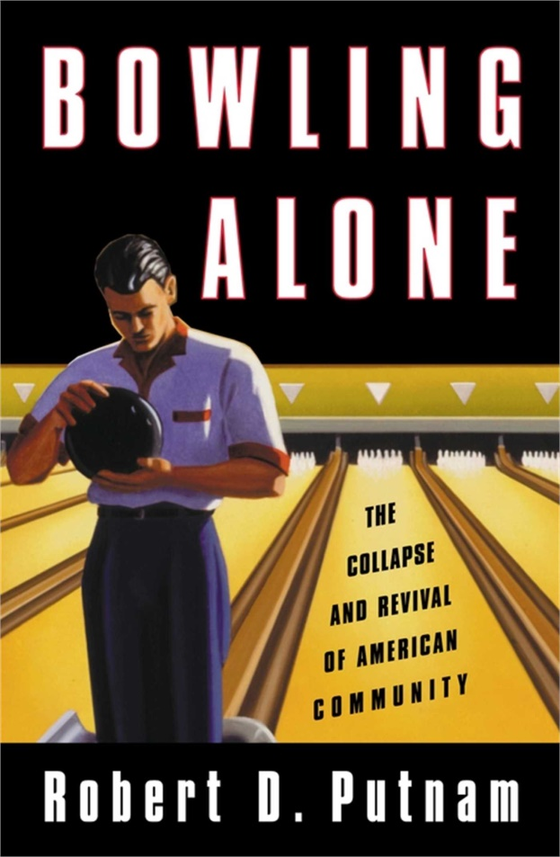
Shrinking appetite for civic space

Slide 47
Water levels at SWAN
In the last 5 years of available data:
Physical circulation has dropped 21%.
After historically large investments in programs and renovations…
Site visits still dropped 4%.

Slide 48
The gradual nature of “climate change”
SWAN public libraries are not in imminent danger of extinction.
But what is increasingly endangered is a critical existential justification for public libraries:
“Free information and civic space FOR ALL”

Slide 49
The existential threat
The threat is that SWAN public libraries over time become more irrelevant to well resourced populations:
Readers frustrated with the “Google Gap” and are willing to pay Amazon accordingly
Media consumers with plentiful broadband and streaming services
Residents with plentiful commercially provided “civic space” (e.g. Starbucks)
Students in well resourced school districts that provide Maker spaces, 3D printing, afterschool study space, etc.

Slide 50
The political threat
History shows that the most durable publicly funded programs are those that are viewed and experienced as something “for all” (Social Security).
The most vulnerable publicly funded programs are those that are viewed as targeted for low income populations (Food Stamps).
This vulnerability especially increases in fiscally constrained contexts (like Illinois).
Notes:
Think of the difference between Social Security (the third rail) versus food stamps

Slide 51
The political threat
If SWAN libraries allow the “Climate Change” to progress unchecked, it risks becoming less like Social Security and more like Food Stamps.
This is a long term threat – it is not imminent.
But long term threats are only met effectively with long term intention and planning (mission clarity).
Notes:
Think of the difference between Social Security (the third rail) versus food stamps

Slide 52
Assessment of SWAN
But in the long term, member libraries are facing a “Climate Change” problem.
SWAN must clarify whether its mission should evolve to also encompass this larger problem.
If SWAN chooses to take on “Climate Change,” it must expand how it conceives sharing technology infrastructure and resources.

Slide 53
The question is about setting mission in the LONG TERM
SWAN is not positioned to start tackling “Climate Change” problems right away.
According to interviews and the recent survey, there is a meaningful level of sentiment that SWAN still needs to improve as a “Public Utility.”
Until that happens, SWAN must be careful about how much bandwidth – much less money – is devoted to anything not related to ILS (as is) performance.

Slide 54
The question is about setting mission in the LONG TERM
However, long term mission clarity does matter. This is the time to ask “big picture” questions.
It matters even for how SWAN should approach a variety of short term issues.
Example: Whether and how to explore open source

Slide 55
Some caveats
Choosing to take on the “Climate Change” problem in the long term does not mean abandoning the “Public Utility” problem or doing it less well.
Taking on the “Climate Change” problem would not mean SWAN becomes an entirely different kind of entity (i.e. an advocacy group or think tank). SWAN likely will remain focused on sharing technology infrastructure and resources.
Staying as a “Public Utility” is a perfectly defensible - and frankly safer – position to take.
Passion and risk tolerance matters.

Slide 56
A case for why SWAN should tackle “Climate Change”
If there is a solution, it most likely will be developed by an entity that possesses the following traits:
Adept in technology infrastructure
Provides a framework for sharing and collaboration between individual libraries
Attuned to patron needs and expectations
Just big enough (for sharing) and just local enough (for specifics of patron communities)
Governed and staffed in a way that enables risk and leadership

Slide 57
A case for why SWAN should tackle “Climate Change”
SWAN is the entity that comes closest to meeting those requirements for this region.
There are no other plausible alternatives:
RAILS
ILA
ALA
Other networks

Slide 58
A case for why SWAN should tackle “Climate Change”
There is no one else coming to the rescue.

Slide 59
Assessment of SWAN
But in the long term, member libraries are facing a “Climate Change” problem.
SWAN must clarify whether its mission should evolve to also encompass this larger problem.
If SWAN chooses to take on “Climate Change,” it must expand how it conceives sharing technology infrastructure and resources.

Slide 60
Expanding the conception of shared technology infrastructure
“SWAN is an organization of Member Libraries (“Members,” “Membership”) participating in an Integrated Library System (“ILS”)…”
SWAN’s mission is too narrowly defined around the ILS.

Slide 61
Expanding the conception of shared technology infrastructure
An ILS is an especially fixed piece of infrastructure and fosters a“fixed” ethos (i.e. standardization, categorization, rules, slow development, etc.)
The equation that the ILS is THE “shared technology infrastructure” inhibits the creativity, nimbleness, and risk taking necessary for innovation.

Slide 62
Expanding the conception of shared technology infrastructure
Examples of other “technology infrastructure” that – if they were shared - could foster more of a lab-like ethos within SWAN:
Websites
CRMs (Customer Relationship Management)
Big Data and AI
Data visualization software
Constituent communications platforms

Slide 63
Expanding the conception of shared technology infrastructure
Even focusing on the ILS, the closed nature of commercial ILS systems inhibits the lab ethos.
“We can’t do that.” becomes the default posture rather than “Hmmm, let’s try that.”
The biggest gain of the Evergreen open source adoption for its members was the dramatic expansion of their creativity and confidence to innovate.

Slide 64
Expanding the conception of shared resources
The conception of “shared resources” covered by SWAN/ILS remains constricted to the traditional types (books and media).
Yet, libraries have dramatically expanded their own definition of “resources.” Physical space and programming have received the greatest investment and growth.

Slide 65
Why aren’t SWAN libraries sharing access to space/programs?
Every reason why libraries serve their patrons better by sharing books applies to space and programs:
Greater availability
Allows for potential specialization and avoidance of unnecessary duplication
Convenience
Matches how patrons think and live (trans-municipal boundaries)

Slide 66
Why aren’t SWAN libraries sharing access to space/programs?
Every theoretical objection why libraries shouldn’t share space and programs apply to the the sharing of books:
Preference for one’s “own” tax paying patrons
Need for consistent rules of access and eligibility
What technology infrastructure will support the sharing?

Slide 67
The connection between sharing resources and technology infrastructure
A troubling question:
Why hasn’t the increased investment in space and programming resources paid off in greater visits?
One likely answer:
Information gap between libraries and patrons.

Slide 68
The information gap
Examples from recent Pew study:
62% of libraries offer career resources
38% of adults don’t know whether their library offers them
35% of libraries offer high school equivalency classes
Nearly half of adults don’t know whether their library offers them

Slide 69
Why this information gap?
To grow programs and space usage, many individual libraries are relying on inadequate technology infrastructure.
“But it’s on our website…”

Slide 70
Inadequate technology infrastructure
What is missing:
Problems with the website itself: design, mobile optimization, etc.
Inadequate website functionality: “Is the meeting space available when I need it? Can I reserve online? Get reminders?”
A reason why a typical resident to go to the library website in the first place.

Slide 71
Inadequate technology infrastructure
Most libraries lack:
Sophisticated SEO and online advertising
E-outreach across multiple channels
Intelligent prediction of patron interest and customized outreach
Other technology infrastructure that drives audiences to a website or delivers information directly without requiring audiences to take that extra step.

Slide 72
The tool kit needs the lab
Increasing sophistication of technology has conditioned patrons to expect resources to find them - not the other way around.
“But it’s on our website…” is insufficient.
Most individual libraries cannot develop the necessary technology infrastructure on their own.
Without a shared lab to devise common solutions, investment in space and programming resources will be filling a leaky bucket.

Slide 73
Recap of the mission question
Should SWAN try to become that shared lab?
In other words, should SWAN take on the “Climate Change” problem?
And if not SWAN, then who will?

Slide 74
Feedback and Discussion

Slide 75
Four Clarification Issues
Identity: How do you make decisions?
Direct Democracy vs. Representative Democracy
Member-centric vs. Mission-centric
Mission: What is the problem you are trying to solve?
3. “Public Utility” problem vs. “Climate Change” problem
Vision: What does your solution look like?
4. Software as End Product vs. Software as Transformative Platform

Slide 76
The future of SWAN
We believe SWAN’s future is still going to revolve around providing software solutions (not as an advocacy or think tank organization).
But what kind of software solutions?

Slide 77
End Product vs. Transformative Platform

Slide 78
Software as End Product
In its current vision, the best possible future of SWAN software solutions is for the ILS to be like Microsoft Word:
Reliable
Defined and strong feature set
Relatively affordable

Slide 79
Software as Transformative Platform
The power of Google is how it is a platform to transform so many other areas of life:
how we get directions, email, store photos, calendar, etc.

Slide 80
The question of vision
What would SWAN software solutions look like as a Transformative Platform?

Slide 81
An hypothetical future…
A Westmont woman checks out a book on pregnancy.
She sees a targeted ad on her social media feed about a prenatal yoga class offered by the Clarendon Hills library (which AI has recognized s actually closer to her home).
Meanwhile, Westmont and Clarendon staff receive from the common CRM a report showing a sharp rise in households with two children under five years old.
Westmont and Clarendon Hills staff collaborate to schedule pre-K drop off reading programs to coincide with prenatal classes.
An email is sent to the Westmont woman with a one click sign up to both classes.

Slide 82
The question of vision
This hypothetical example may seem far fetched (and perhaps ethically questionable) for many librarians.
But it is already a current reality for your patrons in the rest of their lives.
That is how Software as Transformative Platform works for the rest of the world.

Slide 83
The question of vision
Do you want SWAN to turn that (already emergent) vision into a reality for public libraries?

Slide 84
The strategic dilemma
Currently, most SWAN members only desire and expect delivery of a better end-product.
How does SWAN meet, manage, and also transform those expectations?

Slide 85
Feedback and Discussion

Slide 86
Recap and Next Steps

Slide 87
Four Clarification Issues
Identity: How do you make decisions?
Direct Democracy vs. Representative Democracy
Member-centric vs. Mission-centric
Mission: What is the problem you are trying to solve?
3. “Public Utility” problem vs. “Climate Change” problem
Vision: What does your solution look like?
4. Software as End Product vs. Software as Transformative Platform

Slide 88
What should be decided by the board today
Are these the right big picture questions that SWAN must clarify?
Are we prepared to make the necessary clarification decisions (not necessarily today, but soon)?
When will we reconvene to do so?

Slide 89
Timeline of Next Steps
Sept 21 (today): Board agrees that these are the key questions that require decisions from the board.
Between today and Oct. 19: Informal conversations between members
Oct. 19: Board establishes as much clarity as possible. This can range from, “We choose A and need a strategic plan that gets us going…” to “We are unable to choose between A and B now and need a strategic plan that helps us eventually choose.”)
Between Oct. 19 and Nov. 16: CWR develops a Strategic and Tactical Plan based on board decisions reached above.
Nov. 16: Board reviews Strategic and Tactical Plan (CWR to present remotely)
Dec. 6: Board and ED report backs to membership at Quarterly Meeting (CWR will be available remotely)

